Slide 1

Network DevOps Transformation
DevOps Terminology, Roles and Strategy

Slide 2

Agenda
WHAT IS DEVOPS?
DEVOPS TRANSFORMATION ROLES
DEVOPS TRANSFORMATION GOAL
DEFINE SPECIFIC DEVOPS ROLES
THE PATH TO SUCCESS
NEXT STEPS
QUESTIONS

Slide 3

What is DevOps?

Slide 4
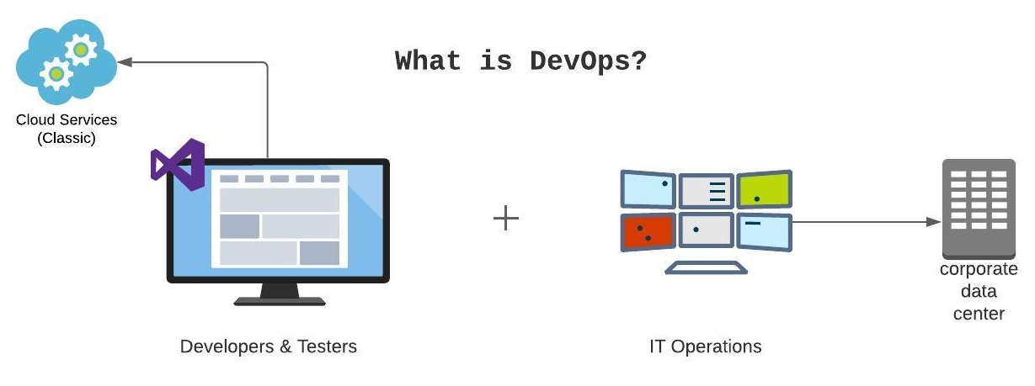
What is devops?
DevOps brings together the development and operations groups for a faster, more accurate, and more responsive software delivery experience.
Success relies heavily on collaboration between all team members involved in a particular project.
The DevOps approach encourages more collaboration between the operations and development teams, ensuring everyone’s objectives are more aligned.

Slide 5
What does development in devops mean?
Primary objective is to convert ideas into a product that solves end-users’ problems.
Requirements gathering
Design
Development
Testing
Product Backlog refinement
Ensuring continuous delivery

Slide 6
What does ops in devops mean?
Primary objective is to deploy the product and manage it throughout the product’s life.
Configuration management of network gear
Managing outages
Managing backups and security
Deployment and maintenance

Slide 7
Transformational Leadership & The Kernel Team

Slide 8
Transformational leadership
Who they are
Managers focused on the growth of their employees and teams
Create a vision of a better path forward for our organization
Inspire and Motivate their employees and teams
Reformers who can explain the why behind DevOps
DevOps culture builders
Responsibilities
Budgeting
Performance reviews
Career Development
Specific functional skills development of staff
Hiring
Capacity planning

Slide 9
The kernel team
Who they are
A group of skilled technical leaders who support the transformation
Coach, lead by example and coordinate the activities of their teams with the big picture
They will be backed and incentivized to cooperate by the Transformational Leaders
In exchange, they will escalate the big picture of the direction our organization is and should be moving in
Responsibilities
SME’s who fully understand and contribute to the architecture, design and development of the CI/CD infrastructure and its workflows
Perform in depth testing and development in preparation for product release
Determine the specific tools required for CI/CD workflows
Vision for automating manual, repeatable processes which evolves into an ADO Feature/Story
Highly collaborative both within Network Teams and many other Teams (Cloud Landing Zone’s, Core services, etc) across the organization
Lead, guide and mentor junior DevOps engineers on all CI/CD processes

Slide 10
#1 Goal in DevOps Transformation

Slide 11

Our main goal
The ultimate goal of DevOps transformation is arriving at the self-organizing system in which teams collaborate effectively simply because that’s how things are done, simply because they trust, understand and respect each other.
This is a beautiful vision. As beautiful as a large codebase with zero bugs.
- Anton Weiss, Principal Consultant and CEO at Otomato

Slide 12
DevOps Lead Roles

Slide 13
Development lead
A step above a software developer
Were once developers themselves
The mid-point in the path between being a developer and being the solutions architect
Rooted in the reality of the code and the capabilities of the developers they have working on the project
Lead and mentor junior developers through problems they don’t understand
In many organizations the development lead isn’t burdened with the formal administrative management of employees, they are instead freed to focus their time on helping developers be successful

Slide 14
Test Automation Lead
Software developer
Responsible for turning new requirements into code
Unit and build testing, deployment and ongoing monitoring
Look for processes that can be automated to increase reliability
Use software programs to test applications and minimize the chance of human error
Identify bugs and create ADO stories to fix them

Slide 15
DevOps Lead
Handles the entire DevOps lifecycle
Design and develop scaling strategies, automation scripts, and solutions to implement, streamline and execute the software
Possess sound knowledge of various tools and technologies used by other team members
Liable for automating all the manual tasks for developing and deploying code and data to implement continuous deployment and continuous integration frameworks
Responsible for creating software deployment strategies
Stays abreast of industry trends and best practices by conducting research, tests and execute new techniques which can be reused and applied to the software development project
Develops self-service solutions for the engineering department to deliver software with excellent quality and speed

Slide 16
The Path to Successful DevOps Transformation

Slide 17

Value & understand our people
In unsuccessful DevOps initiatives the organization fails to realize that people are the most important component of the equation, these organizations often assign members to their new DevOps teams before they have fully understood and documented both the soft and technical skills required for a high-performing DevOps team. They fail to realize that not all personnel have the acumen or desire necessary for success in a highly fluid and collaborative environment.
- Gerry Leitao, VP Capgemini North America
This Photo by Unknown Author is licensed under CC BY-SA

Slide 18

Teamwork makes the dream work
Culture of sharing, learning and experimentation
Open lines of communication
Highly collaborative
DevOps is a team sport and when things go wrong everyone steps in to make it right.
No one wants to look bad, if they know they’ll be shamed for making a mistake, they’ll shut down, and all your DevOps gains will be lost.
Create a culture that celebrates wins and forgives and forgets losses.
This Photo by Unknown Author is licensed under CC BY-SA

Slide 19

What’s next
LOOKING AHEAD

Slide 20
Next steps
Weekly standup/touch base with the Kernel Team and Transformational Leaders
Ensure we’re communicating and understanding each other’s processes
Determine if there’s anything needed to support each other as we progress
Shouldn’t be strictly focused on technical aspects but more on processes, procedures and project requirements
Focus on roadblocks, needed training, budgeting, and capacity across our teams
Ensure that we prevent any disconnect from the reality of our work
Create Network DevOps Lead communication pathways:
Email DL
Membership would mirror our current ADO PR approval group: “Network Cloud Leads”
Add new members as we progress with our DevOps transformation
Teams channel for questions
ServiceNow group

Slide 21
Questions?

Slide 22
sources
The 4 roles of DevOps leadership - Anton Weiss https://jaxenter.com/4-roles-devops-leadership-134912.html
What is DevOps: Get an in-depth Understanding of DevOps https://www.simplilearn.com/tutorials/devops-tutorial/what-is-devops
How to Build DevOps Culture: A Guide for CXOs https://www.netsolutions.com/insights/how-to-build-devops-culture/
Anatomy of a Software Development Role: Development Lead | Developer.com https://www.developer.com/project-management/anatomy-of-a-software-development-role-development-lead/
DevOps Lead Engineer Job roles and responsibilities https://www.invensislearning.com/blog/devops-lead-engineer-job-roles-responsibilities/
7 key DevOps roles organizations need for a successful transition https://techbeacon.com/devops/7-devops-roles-you-need-succeed

Slide 23


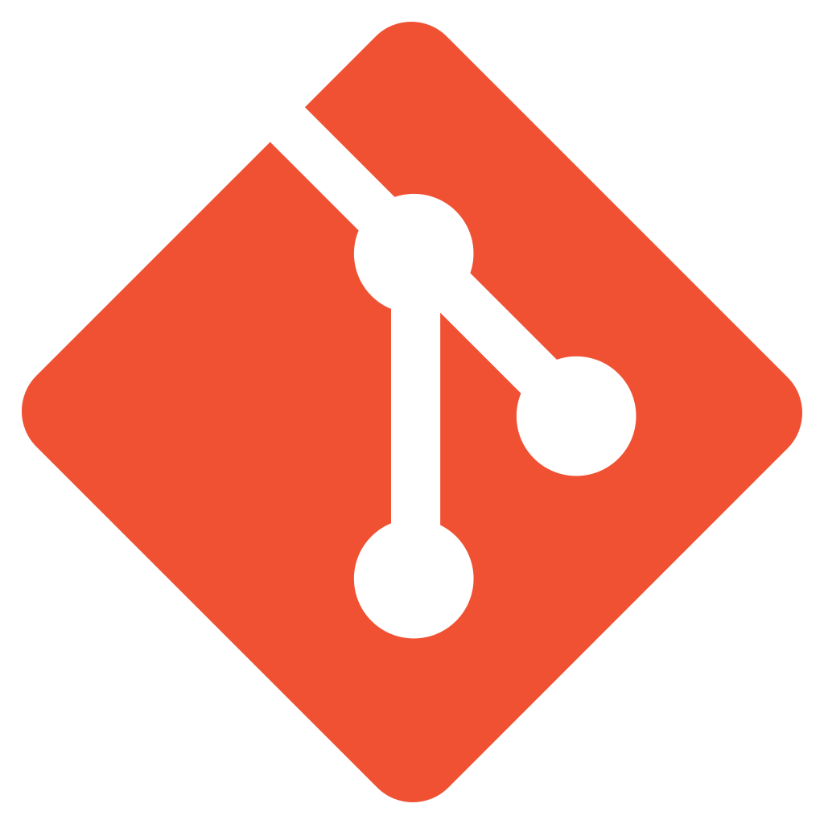
THANK YOU
JENNA SPRATTLER
jennasprattler
jksprattler
WWW.JENNASPRATTLER.COM

